Slide 1


Problem Statement
Drivers who are tired or sleepy can cause accidents that harm people, when a driver is getting tired and remind them to take a break.
We need a system that can detect when a driver is becoming drowsy and alert them to take a break.

Slide 2

Methodology
Collect a dataset of images and videos
Extract facial features
Train a machine learning model
Test and validate the model
Integrate the model into a real-time system
Evaluate the effectiveness of the system
Deploy the system in relevant settings

Slide 3

Brainstorming
Accuracy:
The accuracy of the system may be affected by various factors, such as lighting conditions, camera quality, and the driver's physical appearance, which may impact the system's ability to accurately detect drowsiness
Privacy concerns:
The system involves the use of cameras and facial recognition technology, which may raise privacy concerns for some drivers. The system may also store images of the driver's face, which may be a potential security risk.

Slide 4

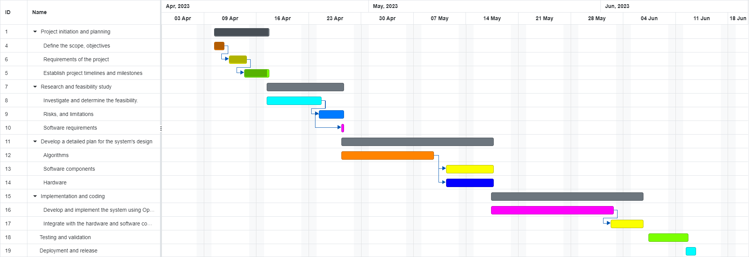
Gantt Chart

Slide 5
Feasibility
Technical feasibility:
Open CV is used for real-time image processing and analysis. It has been successfully used for face detection and tracking, Therefore, the technical feasibility of using OpenCV for this Project is Possible
2.Cost feasibility:
OpenCV is free and open-source software, which reduces the cost of software development. However, we need hardware, such as cameras and processing units. The overall cost of the project approximately up to 2000 Rs. We are able to complete this project in our budget
3.Accuracy feasibility:
The accuracy of the system will depend on several factors, including the quality of the camera, lighting conditions, algorithm selection, and the driver's facial expressions and movements.
4. Time feasibility:
This project took approximately 2 months to complete and we are able to complete this project with in the time

